Slide 2
Building a search and visualization system for real estate data from multiple sources

Slide 3

Building a search and visualization system for real estate data from multiple sources
Supervisor: Ph.D. Vũ Tuyết Trinh
Đinh Hữu Đại – 20194735
Global ICT
Notes:
Good [morning/afternoon/evening] everyone. My name is Đinh Hữu Đại, I'm a student in the Global ICT program and today I will be presenting my thesis on 'Building a search and visualization system for real estate data from multiple sources.' I will cover the motivation behind this project, the methodology used, and the results achieved. Let's begin with an introduction to the problem."

Slide 4
Contents
Introduction
2. Overall architecture
3. Data Collection and Integration
4. Data Visualization
5. Conclusion

Slide 5
1. Introduction
Currently:
The real estate market is highly competitive and dynamic.
Demand for real estate is rising, especially in urban areas.
Prices have been pushed too high compared to their real value.
Many platforms list real estate, but the information is scattered.
=> Results in users facing more challenges and spending more time in the property search process.
My thesis delivers a real estate search system that integrates data from multiple sources, featuring search capabilities and visualization tools for property search process.
Notes:
To start, let's consider the current real estate market. It's highly competitive and dynamic, with rising demand, especially in urban areas. However, this demand has driven prices up, often beyond their true value. Many platforms list real estate, but the information is not centralized. This makes it challenging and time-consuming for users to find suitable properties. My thesis aims to address this by developing a system that integrates data from multiple sources, featuring search capabilities and visualization tools for the property search process.

Slide 6
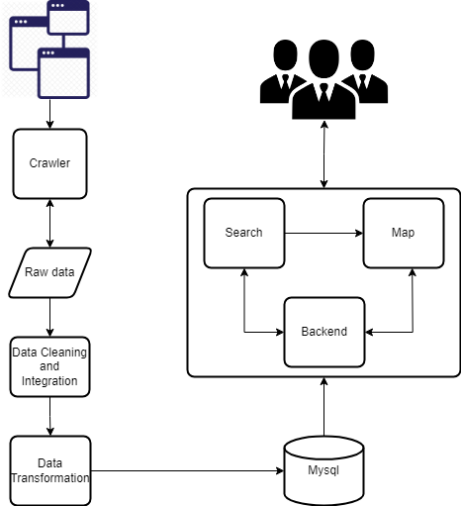
2. System Architecture Design
Crawler
Beautifulsoup
Selenium
Data Integration
Pandas
Geopy
Database
Mysql
Website
Django
ReactJS
Notes:
This slide outlines the overall design of the system. The core components include a web crawler built using BeautifulSoup and Selenium. The collected raw data is stored in a component known as 'Raw Data.' This data is separated into two categories: txt files and JSON files. Txt files contain links to individual real estate listings without detailed information, serving as pointers for further data extraction. Conversely, JSON files store each real estate property's specific attributes. Data integration handled by Pandas and Geopy, and a MySQL database for data storage. The web server runs on Django, while ReactJS is used for the frontend. Together, these technologies create a system for collecting, processing, and presenting real estate data.

Slide 7





3.1 Source data
After the survey process, based on the reliability, scale of data sources as well as feasibility of implementation, I decided to collect data from 5 main sources:
muaban.net
nhadat24h.net
alonhadat.com
Batdongsan.com.vn
meeyland.com
Notes:
After surveying various data sources for reliability and implementation feasibility, I decided to collect data from five main websites: muaban.net, nhadat24h.net, alonhadat.com, batdongsan.com.vn, and meeyland.com. These sources provide a diverse dataset for my system.

Slide 8
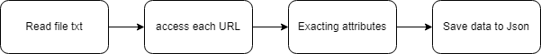
3.2 Data Collection
Technology used:
Requests (Python) / BeautifulSoup or Selenium: create HTTPS requests and parse HTML
Method:
Access the search page url
Get the list url of jobs
Save list url to file txt
Access single real estate page by url and extract data
Write data to file json
Notes:
Based on my survey, I have identified differing technical implementations HTML structure. Specifically, websites like muaban.net, nhadat24h, alonhadat, and meedyland.com use straightforward HTML and employ pagination techniques. For these sites, I will utilize BeautifulSoup to scrape data efficiently. In contrast, batdongsan.com utilizes JavaScript extensively. Besides, there are also mechanisms to limit access to data collected automatically. Therefore, I have opted to employ Selenium for scraping batdongsan.com.
In this process to collect links from real estate websites, the method involves iterating through pagination of each website. I use a for loop to replace these pagination values to traverse through the subsequent pages. Each found link is checked and appended with the base URL of the website to form a complete link.
Next I will Access single real estate page by url , extract detail data and write to file json

Slide 9
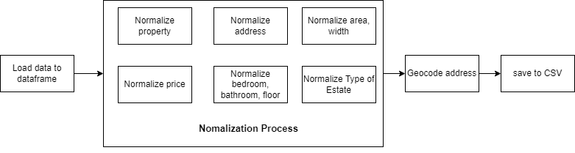
3.3 Data Integration
Technology used:
Pandas library: clean and standardize data
Geopy: address coordinates
Pymysql: load data to database
Notes:
After collecting data, I see that there are some conflict between five sources so I must perform the data integration process. In this, we use Pandas for data cleaning and Normalization, Geopy for obtaining address coordinates, and PyMySQL to load the data into a MySQL database. Data cleaning involves removing duplicates, handling missing values, and standarlizing formats.

Slide 10
Data integration process
Extract data
Read data from JSON file
Load it into Pandas Dataframe
Integrate data
Normalization data
Address
Price, area
Bedroom, bathroom, floor
Property type
Geocode address
Load data
Insert data into from file csv to mysql database
Notes:
The data integration process begins with extracting data from JSON files and loading it into Pandas DataFrames. The data is then normalized, which includes standardizing addresses, prices, areas, and other attributes. Finally, the cleaned data is inserted into the MySQL database from CSV files. This structured approach ensures that all data points are accurate and easily accessible for further visualization."

Slide 11
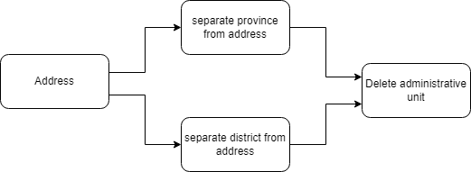
Data Normalization: Address
Create province and district
Delete unit
Notes:
Next slide is Address Normalization, I must Seperate district and province: This involves parsing the address string to create two new fields. By separating these elements, users can search for real estate listings by province or city, making the search process more efficient and user-friendly.
Beside I also need to delete administrative unit: To maintain consistency in geographic data, it is crucial to standard the district and city_province fields. This involves removing any unsuitable information and ensuring that only the standardized names are retained. Due to inconsistent data sources, the same district or city might be referred to by various names (e.g., "Hai Ba Trung District," "Hai Ba Trung,").

Slide 12
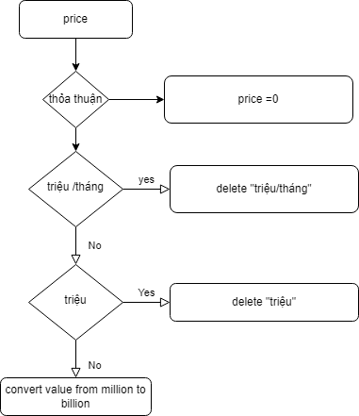
Data Normalization: Price
Delete unit
Value conversion
Notes:
In standardizing property prices for both sale and rental properties This involved identifying key terms like "triệu" (million), "tỷ" (billion), and "triệu/tháng" (million per month) that were used inconsistently across different listings. Using string manipulation techniques, I removed these terms from the price fields. Special cases, such as listings with "thỏa thuận", were handled by setting the price field to a default value of 0. After that, I converted values into numerical formats: included replacing commas with periods to standardize decimal points.

Slide 13
Geocoding Address
Converts into geographic coordinates (latitude & longitude).
Geocoding with Geopy:
Suitable for standard, well-structured addresses.
Use Geopy’s Nominatim
Geocoding with OpenCageData API
Handling Complex Addresses
Integrate OpenCageData API.
Send requests and get coordinates with metadata.
Notes:
Geocoding converts addresses into geographic coordinates (latitude and longitude). We use Geopy's Nominatim for standard addresses and the OpenCageData API for more complex addresses. This step is important for visualizing properties on a map. Geopy is efficient for well-structured addresses, while OpenCageData provides more sophisticated geocoding capabilities for addresses that are less standardized or refer to large projects.
Accurate geocoding ensures that properties are correctly placed on the map, enhancing the user's ability to locate and evaluate them.

Slide 14
3.4 Transfer data to database
Use pymysql
Handle conflict with exiting data
Get all data stored in Mysql
Check similar in area, address, type, kind, wide, number of bedroom, floor,… by pymysql
Update price if similary
Handle missing source data
Notes:
After Intergating data, all information wil save in CSV file . To load them into database I use pymysql library. But before that, I must handle conflict with extiting data by following steps: …… . Finallly I will check missing source data to ensure that not insert data without a geocode, type, kind, type, description field.

Slide 15
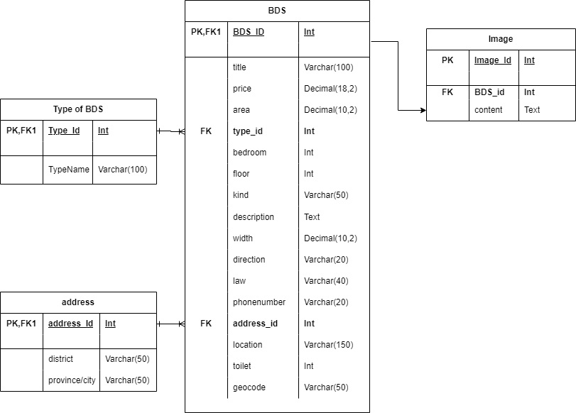
3.5 Database
Mysql
4 tables:
address: province and respective district
Type of BDS: all types of real estate
Image
BDS: detail of each estate
Notes:
The MySQL database consists of four main tables: 'address' for provinces and districts, 'type_of_BDS' for property types, 'image' for property images, and 'BDS' for detailed property information. Each table is designed to store specific types of information, ensuring that the data is organized and easily accessible.

Slide 16
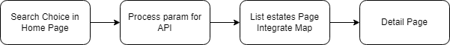
4. Data visualization
Technology used
Django for backend
ReactJS for frontend: leaflet for map, Highchart for barchart
MySql for storing data
Notes:
After Data Collection and Integration process, I will present data visualization process. I can say: "Data visualization is a key part of this project. The backend component uses Django to provide APIs that take user requests from the frontend, pull the required data out of the MySQL database, and send it back to the frontend. The visualization tools help users interact with the data meaningfully, providing insights into the real estate market.

Slide 17
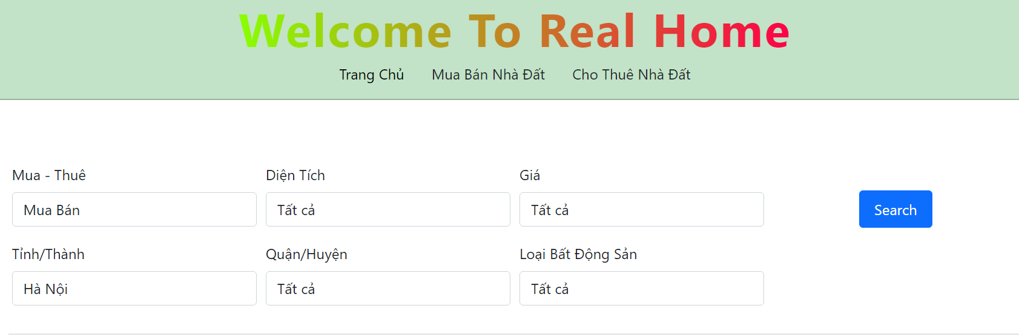
Data Visualization: Search Component
Search real estate by six main
properties
Filter by type name
Notes:
In Main page, users con find real estate by six main attributes or filter by type name. For province or district, I call api to get all data of two field in database. With the price and area fields, users can choose value domains, but to facilitate data retrieval, these options need to be assigned to minprice, maxprice or minarea, maxarea.

Slide 18
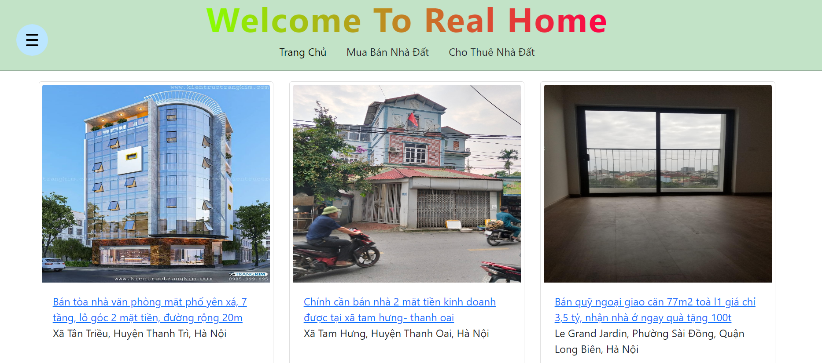
Search Component
Notes:
After enter search button, it is passed to the /list-estate page. Here, the data is retrieved again and a geocode variable is built to serve as an input parameter for the map.

Slide 19
Data visualization: Map Component
Geospatial Data:
address data in geocoding
Provides input for interactive map and chart features.
Preprocessing:
Prepare 'geocode' parameters:
Coordinates (latitude and longitude)
Price, Area, Image, Title
Utilizes 'geocode' parameters for accurate data representation.
Notes:
Geospatial data, including geocoded addresses, is used as input for the interactive map features. Before calling the Map component, we prepare the 'geocode' parameter, which includes coordinates, price, area, image, and title for each property. This ensures accurate representation of data points on the map. The map provides a visual overview of property locations and their distribution, allowing users to see where properties are located relative to each other and to important landmarks.

Slide 20
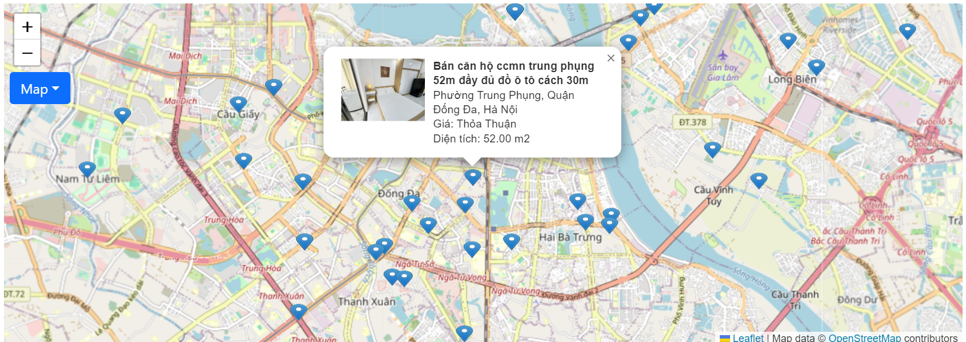
Map visualization
Notes:
This slide demonstrates the map visualization. Each property is represented by a marker on the map, and users can interact with these markers to view more details about each property. Clicking on a marker opens an information window with based property information, including images and price, area. If you want more detail can choose link in image.

Slide 21
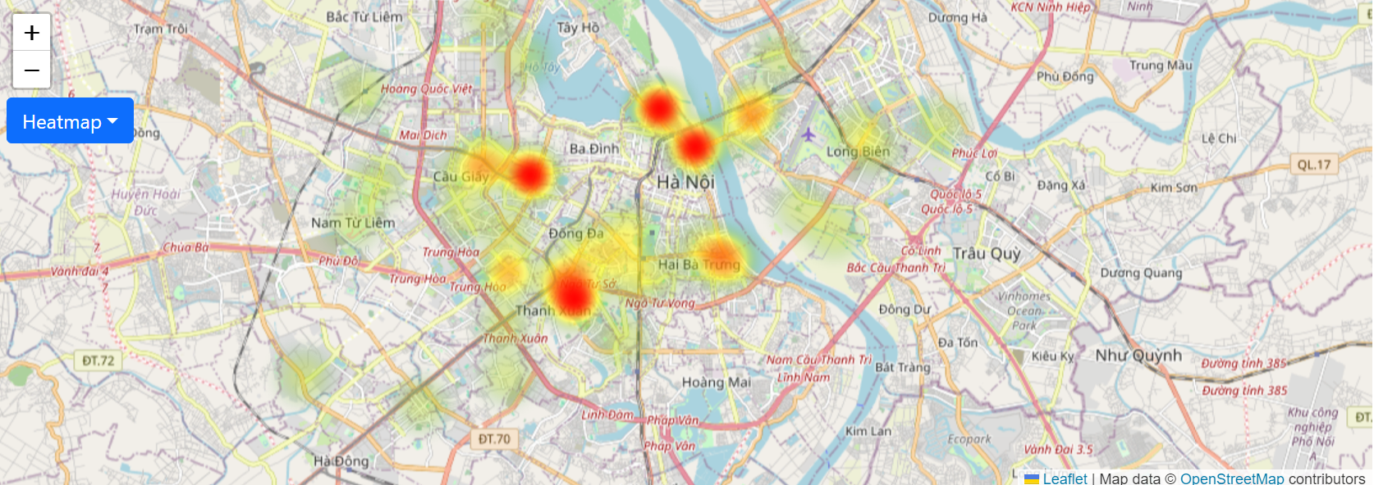
Heatmap visualization
Notes:
In addition to the standard map, we also provide a heatmap visualization. This feature highlights areas with high concentrations of properties. The heatmap uses color coding to show areas of high and low property density, helping users to identify hotspots and trends. This visualization tool is particularly useful for investors and developers."

Slide 22
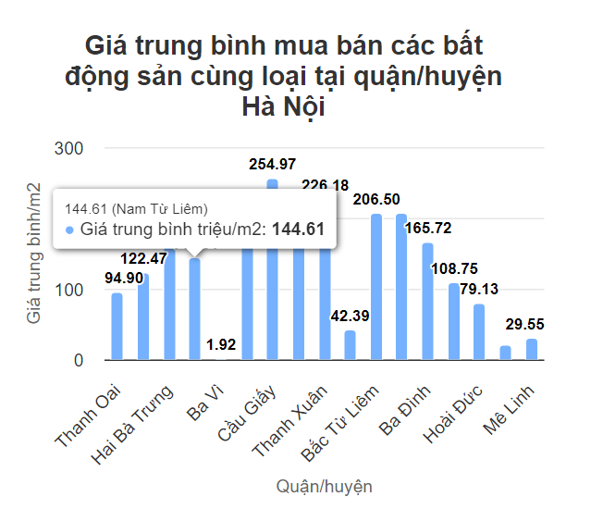
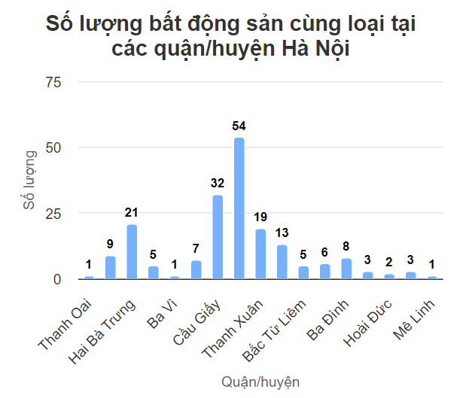
Visualization: Barchart
Notes:
In detail page, I provide two bar chart for user. They are chart for average price, the number of real estates of each district in same type and province “. With two chart, customer can have more analysis before decision.

Slide 23
5. Conclusion
Future Work:
Optimize data collection and cleaning processes
Enhance interactive visualizations and advanced mapping features
Expand system support for new data sources.
Conclusion:
Developed a robust system for real estate data management and visualization.
Integrated data from diverse sources
Addressed challenges in Intergration process, while achieving effective data standardization.
Notes:
Conclusion:
"We've developed a robust system for real estate data management and visualization. By integrating data from diverse sources and addressing integration challenges, we achieved effective data standardization. This system ensures accurate, standardized, and easily accessible real estate information."
Future Work:
"We plan to optimize data collection and cleaning processes, enhance interactive visualizations and advanced mapping features, and expand support for new data sources. These improvements will further enrich the system and provide users with deeper insights and a better experience."

Slide 24
THANK YOU !

